Slide 1
Global education experience in preschool, primary and secondary education.
Interdisciplinary approach
By Ina Lužkienė
Kaunas Simonas Daukantas
progymnasium
2016-03-16

Slide 2
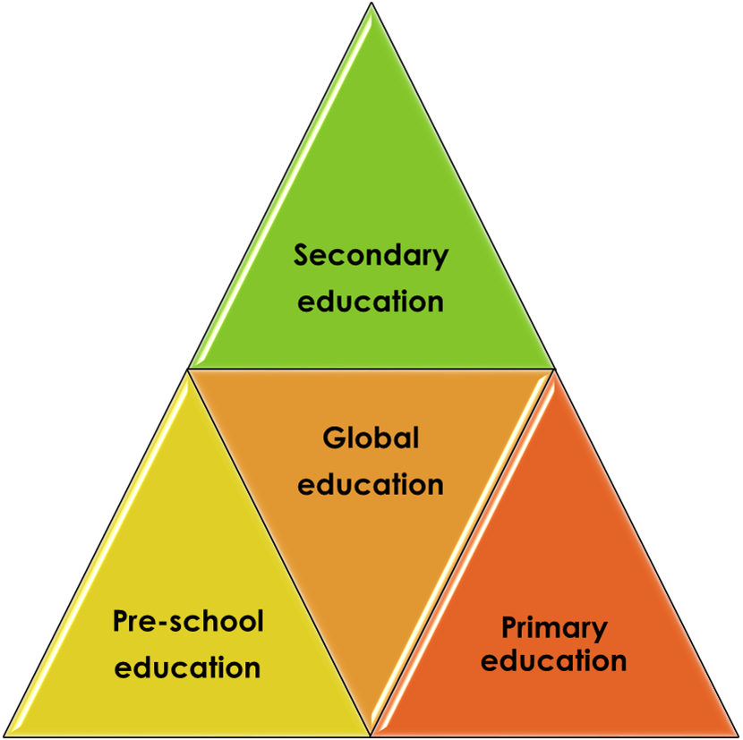
Cross-institutional
Cooperation
Is a key to
Success in
Awaking
Global
Awareness

Slide 3
Global education as a holistic approach
Comprehension skills
Practical skills
Learning skills
Communicative skills
Pre-school level:
Arts and crafts
Tale telling / listening to
Listening skills workout
Asking questions
Puppet play
Literacy and numeracy skills workout

Slide 4
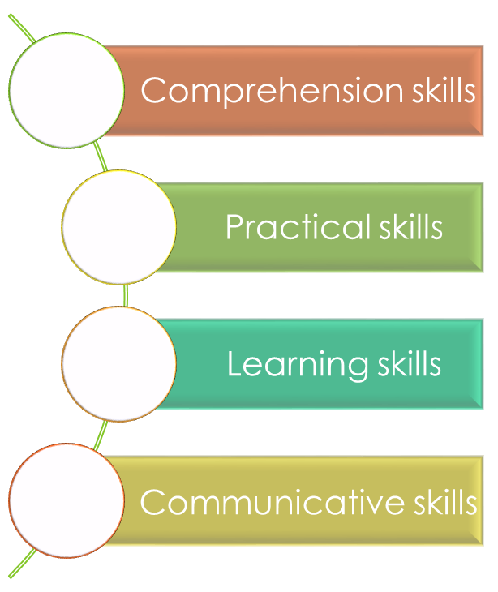


Slide 5
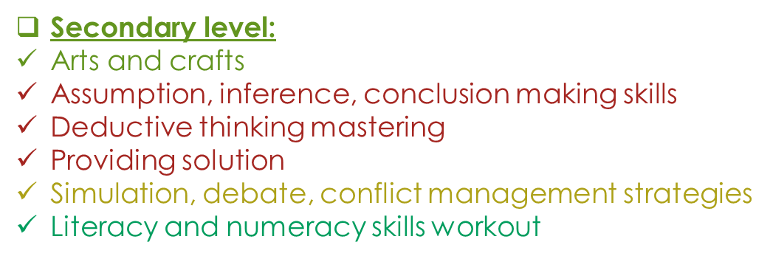

Slide 6
METHODS
DEDUCTION
INCLUSION / IMMERSION
TOOLS
PICTURES
APPS
RESOURCES
WEBSITES
SOCIAL NETWORKS
VIDEOS
STORIES
EXPERIENCING
MEDIA

Slide 7
METHODS
DEDUCTION
INCLUSION
IMMERSION
EXPERIENCING

Slide 8
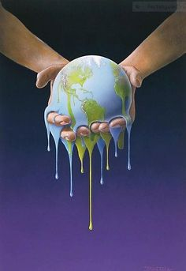
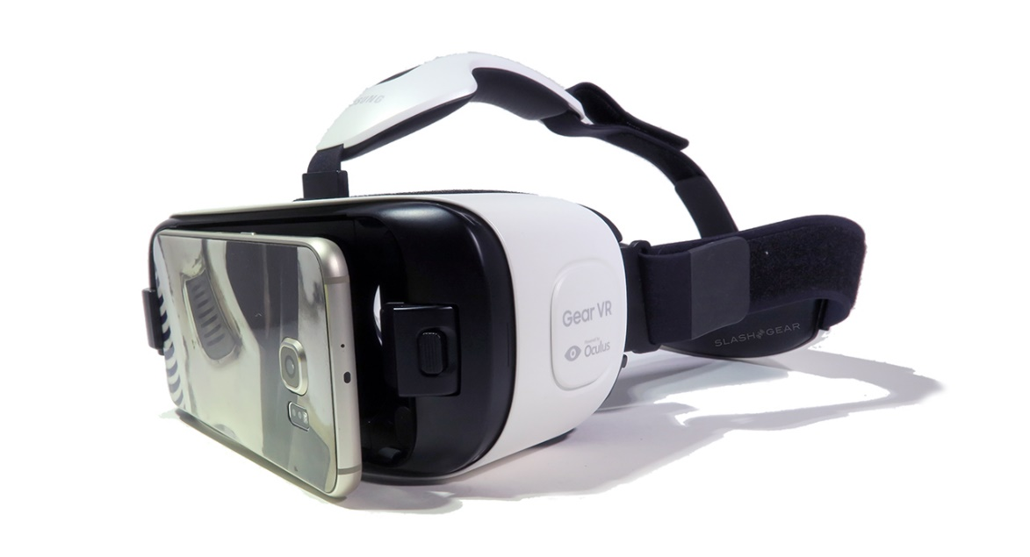
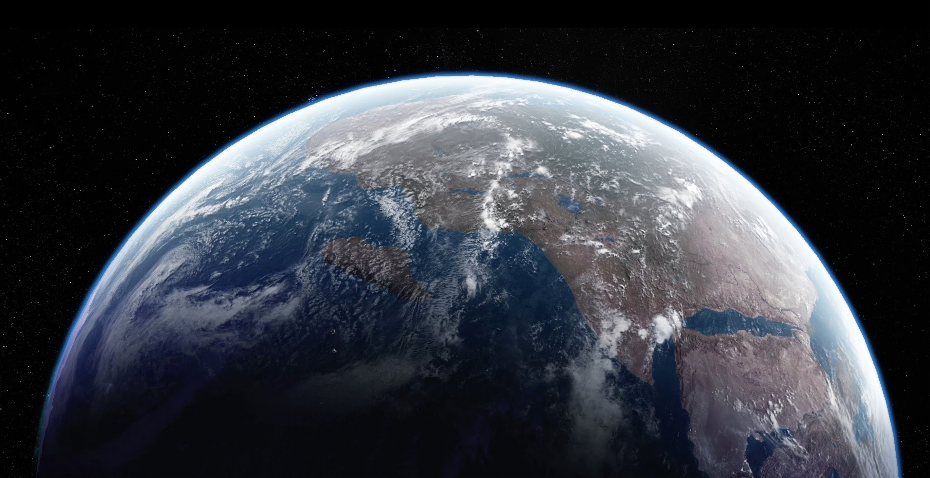
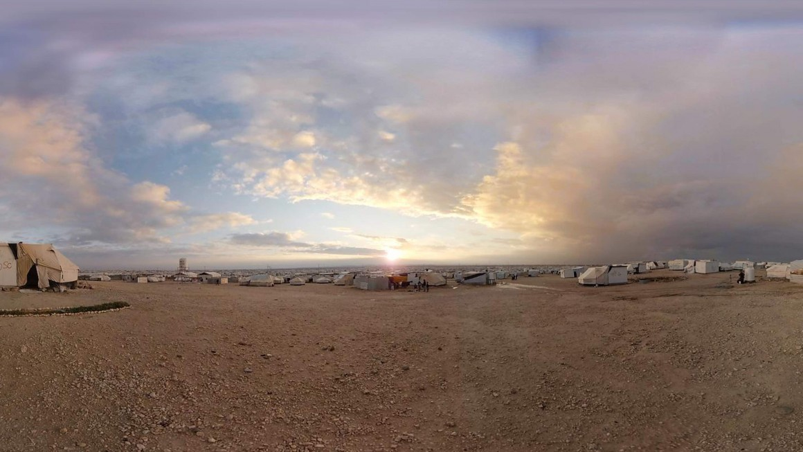
TOOLS
PICTURES
APPS
STORIES
VIDEOS

Slide 9

RESOURCES
WEBSITES
www.globalonenessproject.org:
  Films
  Articles
  Photo essays
  Lesson plans
www.youtube.com:
  Experience360
  Play 3D channel
  Vrse
  Discovery
  Etc.
www.globaleducationfirst.org:
  Sustainable development goals
  Access to education
  Quality learning
  Global citizenship
  Education guidance notes
www.fairtrade.net:
  Videos
  Brochures
  Newsletters

Slide 10
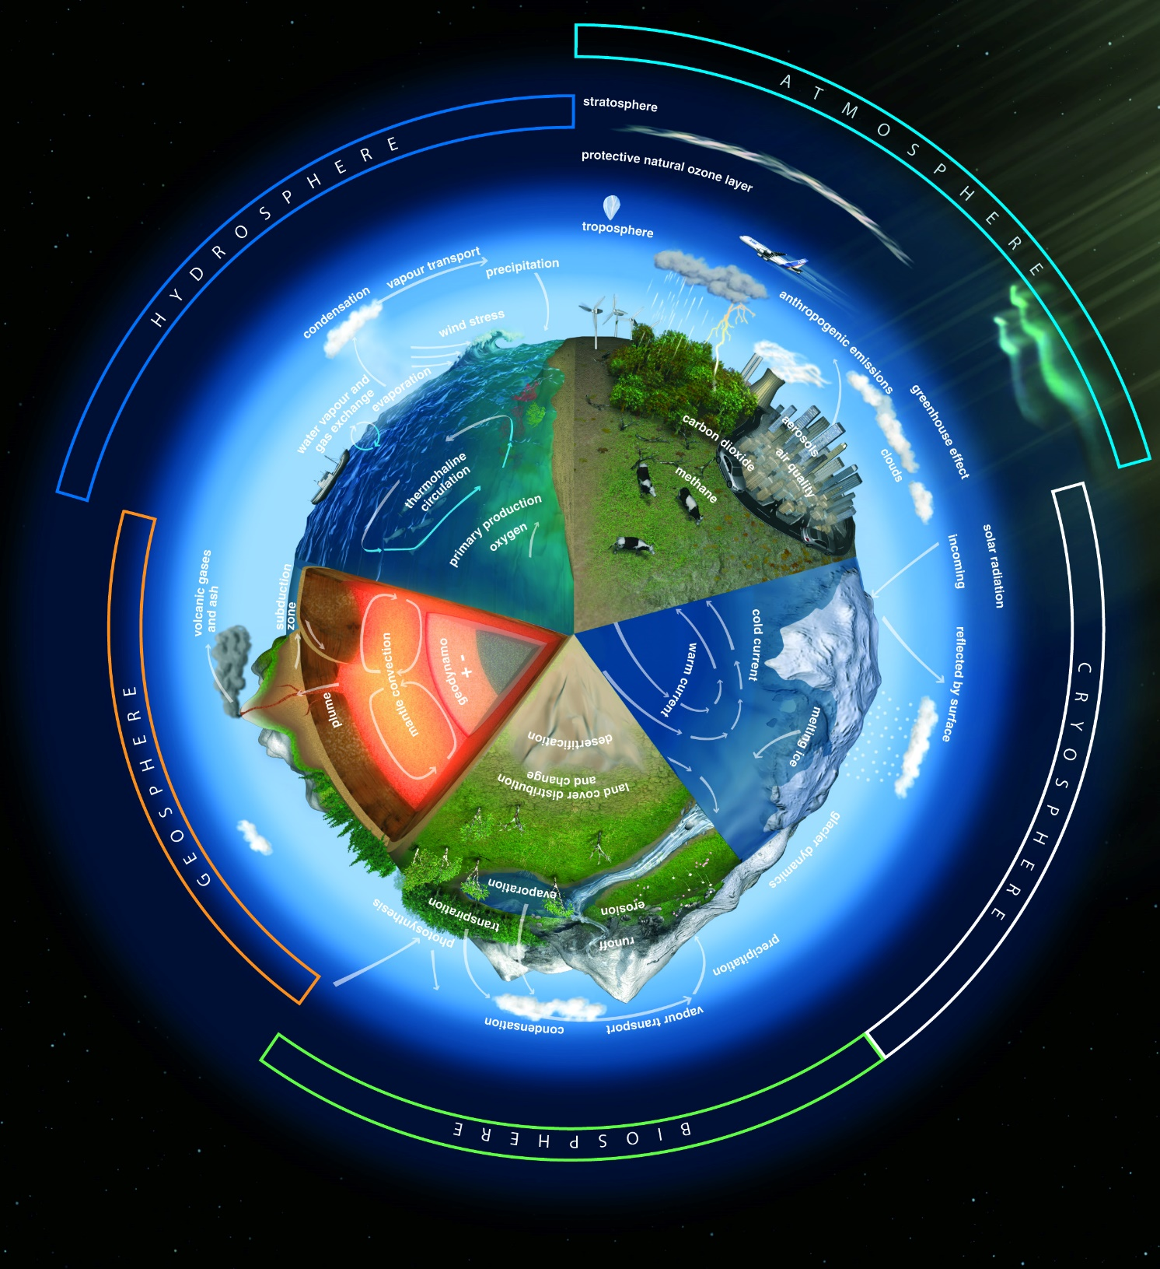
RESOURCES
MEDIA
TV
RADIO
NEWSPAPERS
FLYERS
ADVERTS, ETC.
SOCIAL NETWORKING
Facebook
Twitter, etc.

Slide 11
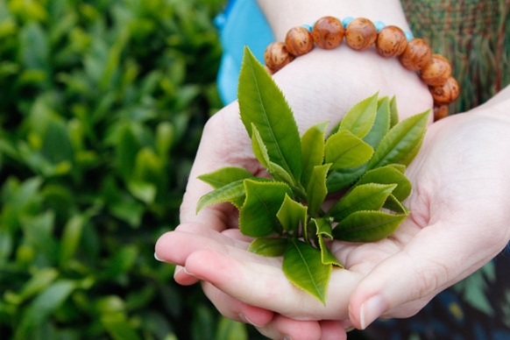

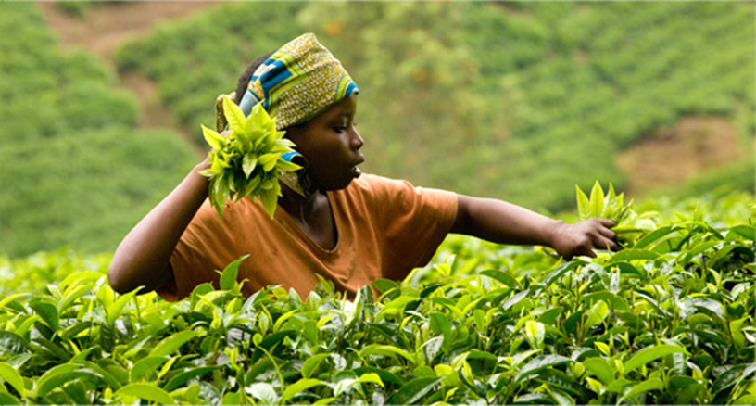


Slide 12
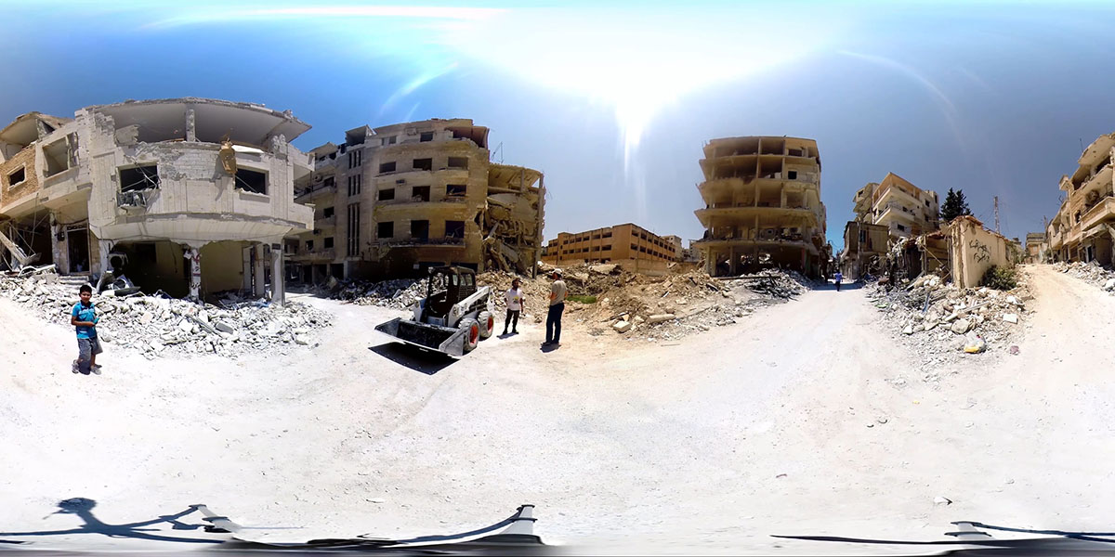
“I was able to see the destruction and isolation all around me, an unsettling way to experience such an event. However, it's another example that VR can go well beyond gaming and has enormous potential for immersive storytelling -- even when the stories are hard to watch.”
Steve Dent
360-degree video
puts you in
a bombed-out
Syrian war zone
“The Battle for Northern Syria
360° Virtual Reality Report”

Slide 13

Thank you for your attention

